Slide 1
Content-Exchanged Based Cooperative Caching in 5G Wireless Networks
GLOBECOM 2017 - 2017 IEEE Global Communications Conference
Shu Fu ; Peng Duan ; Yunjian Jia
Zheng,Hao-Zhong

Slide 2
Outline
Introduction
System Model
Problem Formulation
Discussion About The System Costs
Simulations
Conclusion

Slide 3
Introduction(1/4)
The dramatic increasing amount of smart mobile devices leads to the mobile data traffic growing rapidly, especially the video traffic in recent years.
Since multiple users may require the same contents of remote service providers (RSPs), the repeat transmissions cause heavier burden of backhaul and overhead in the fifth generation (5G) networks.
To improve the utilization of limited resource and cut down the energy consumption, caching is a promising technology in 5G wireless networks.
Notes:
智能移動設備增加 導致移動數據流量 上升 ，尤其是影音流量
很多使用者都從遠端服務提供商那require相同的內容，重複傳輸會在5G網路中造成更大backhaul的負擔
為了提高有限資源的利用率並降低能耗，caching是一個很有前景的技術

Slide 4
Introduction(2/4)
Caching means contents of RSPs can be stored at network edge, i.e., caching content in small base stations (SBSs).
Therefore, the requested contents of RSPs can be obtained directly from either local SBSs or neighboring SBSs without routing from remote servers via core network. This effectively enhances the utilization of spectrum, reduces the delay and lessens the burdens in networks.
Caching content of small base stations (SBSs) is a promising approach in the fifth generation (5G) wireless networks for decreasing the transmission delay and energy consumption.
Notes:
因此，從RSP的請求的內容可以直接從本地SBS或相鄰SBS獲得，而無需通過核心網絡從遠程服務器進行路由。 這有效地提高了頻譜利用率，減少了時延，減輕了網絡負擔。
尤其在第五代（5G）無線網絡中，緩存小型基站（SBS）的內容是一種很有前景的方法，可以減少傳輸延遲和能耗。

Slide 5
Introduction(3/4)
In this paper, we design a novel cooperative caching scheme based on the content-exchanged between SBSs.
Specifically, we consider the scenario that neighboring SBSs could establish cooperate relationship through macro base station (MBS). Cache is configured at each SBS. The contents cached in SBSs can be exchanged via MBS as relay in the considered cooperative caching scheme.
Notes:
在本論文中，我們設計了一種基於SBS之間內容交換的新型協作緩存方案。
具體來說，我們考慮相鄰SBS可以通過宏基站（MBS）建立合作關係的情況。 在每個SBS上配置緩存。 在所考慮的協作緩存方案中，可以通過MBS作為中繼交換在SBS中緩存的內容。
(In the case that the contents requested have been already cached in corresponding local SBS, the serving SBS can transmit the content directly. Otherwise, the local SBS needs to fetch the content via MBS from neighboring cooperative SBS. If the SBSs belong to different telecom operators, SBS should pay for the authority of downloading the data stored in other SBSs.)
如果所請求的內容已經被緩存在相應的本地SBS中，則服務SBS可以直接發送該內容。否則，本地SBS需要通過MBS從相鄰的協作SBS中獲取內容。如果這些SBS屬於不同的電信 運營商，SBS應該支付下載其他SBS中存儲的數據的權限。

Slide 6
Introduction(4/4)
In this paper, the caching space at each SBS is divided into two parts.
The first part is reserved for fixed caching contents (FCC).
The second part is used for caching data for wireless transmission (DWT).
(The optimized proportion between the two parts should be determined for minimizing the systems costs. )
The key contributions in this paper can be described as following :
Proposing a novel cooperative caching scheme.
Exploring the optimal allocation proportion between the capacity of FCC and DWT at each cache.
Notes:
去探討&最佳化 FCC與DWT間分配的比例

Slide 7
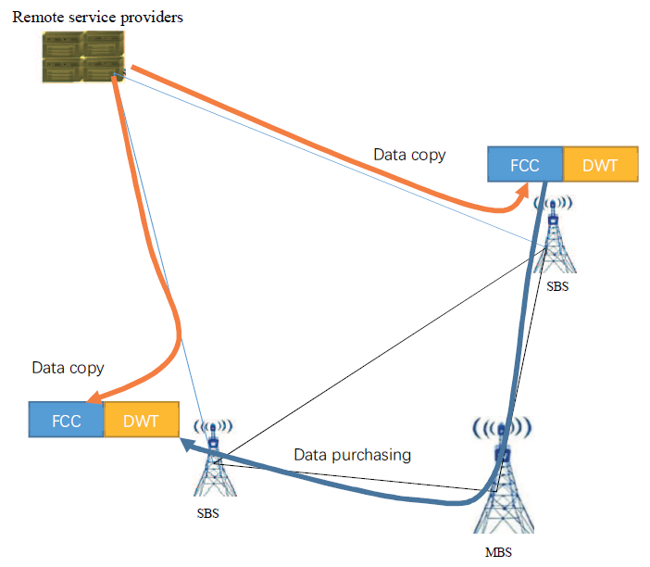
System Model (1/2)
Assume N SBSs and one MBS exist in the system, where the MBS can control the data exchange between SBSs.
Each BS possesses one cache with overall capacity 𝐶𝑛.
The cache at each SBS is further divided into two parts. The one with larger capacity is used as FCC, and the other one with relatively small capacity is used as DWT.
The data in DWT contains data in local FCC and scheduled data from the neighboring SBSs.
We assume that the SBSs belong to different telecom operators, then the SBS required the data from other SBSs should pay for the authority of scheduling.

Slide 8
System Model (2/2)
Assume that the distance between SBSs are relatively large, and thus we can ignore the wireless interference between SBSs.
The data copy from remote service provider will be stored at FCC of SBSs in a cooperative manner.
If the data for wireless transmission is not cached at the local SBS, the SBS should purchase the data copy from the neighboring SBSs.

Slide 9


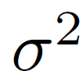
Problem Formulation (1/8)
Assume that the wireless bandwidth is B Hz.
Both SBSs and users work in single-antenna mode, thus SBS can serve at most one user at any moment.
(However, the model can be easily extended to multi-antenna scenario.)
The SBS transmitting power to user j as .
The channel gain from SBS to user j which is in its coverage as .
The Gaussian white noise is denoted as .
The channel gain from an arbitrary SBS to the users beyond its coverage is 0.

Slide 10

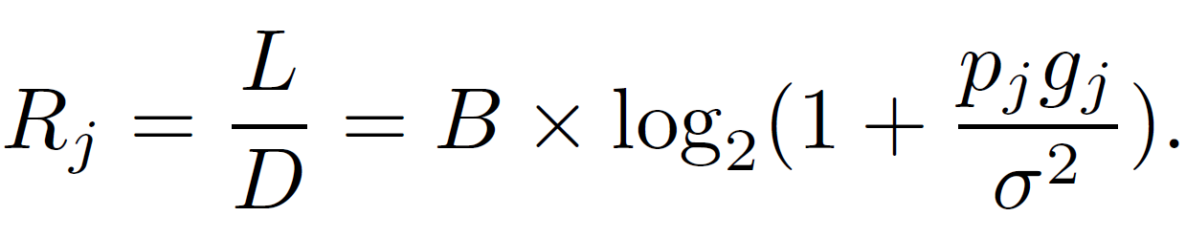
Problem Formulation (2/8)
The wireless transmission rate of user j is presented as .
The capacity of each file is assumed as L bits.
The wireless delay is D seconds.
According to the Shannon capacity formulation, we have
Assume the proportion between FCC and DWT is (1 − 𝛼) : 𝛼 .
where 𝛼 ∈ (0, 1).

Slide 11
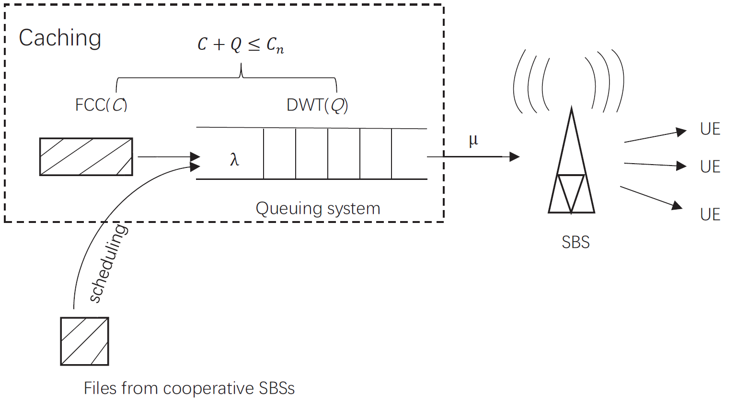
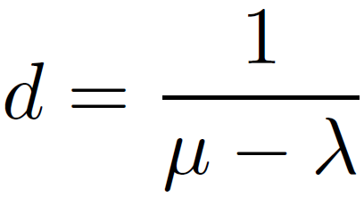
Problem Formulation (3/8)
𝜆 is the arriving rate of service.
𝜇 is the serving rate of each SBS.
𝜌 is service intensity.
Q is the length of waiting queue in DTW.
C is the capability of local FCC.
According to the M/M/1 queuing theory , we can have the delay in the queuing system d
Notes:
到達時間卜瓦松過程（Poisson process）；
服務時間是指數分布（exponentially distributed）
只有一部伺服器（server），遵循先到先服務規則
隊列長度無限制
可加入隊列的人數為無限
rho 表示服務被占用的平均概率
d 在系統中的平均逗留（等候＋接受服務）時間

Slide 12
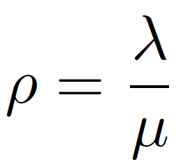
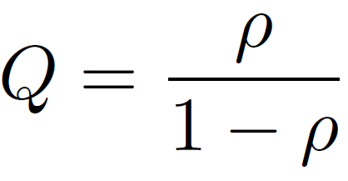
Problem Formulation (4/8)
The service intensity is the ratio of the arriving rate to the serving rate, then we can easily get the service intensity 𝜌
We can further get the length of waiting queue Q , it expresses how many contents are stored temporarily in the DWT.
Notes:
Q 整個系統waiting queue的平均長度

Slide 13
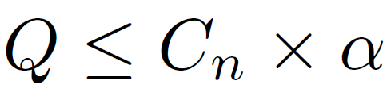
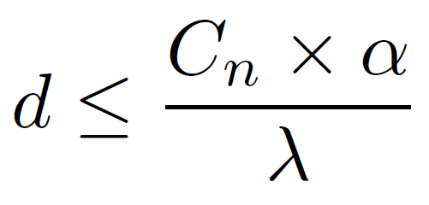
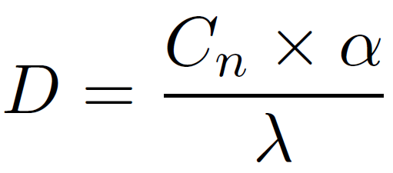
Problem Formulation (5/8)
In order to achieve no packet loss, that is to say , the content stored temporarily in the DWT should not exceed the capability of the DWT, so Q should meet
Then, we can further derive
The delay of wireless D is not exceeding the delay in the queuing system d
Notes:
當 interference between SBSs is ignore 時，要讓wireless 能耗越小 =>wireless delay 要 越大(在系統中的平均逗留（等候＋接受服務）時間)

Slide 14
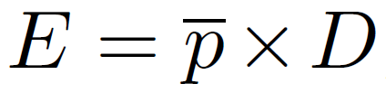


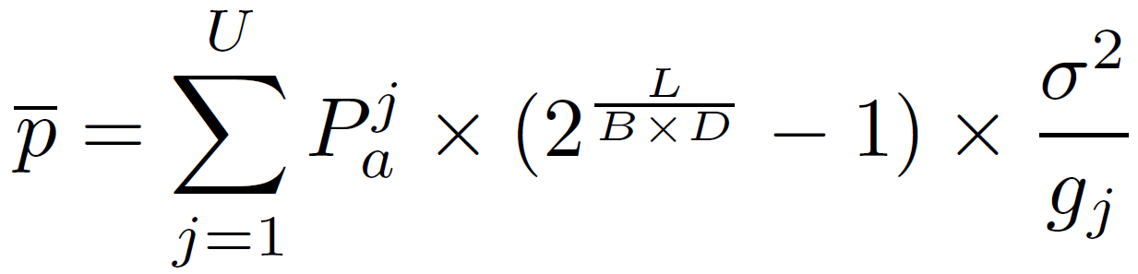
Problem Formulation (6/8)
The wireless energy consumption can be obtained by
(where is the average power for transmitting one file to user covered by the SBS )
We assume there are U users in the system, and the probability of user j receiving one file is , then
Notes:
The wireless transmission rate of user j is presented as Rj
The SBS transmitting power to user j as Pj

Slide 15



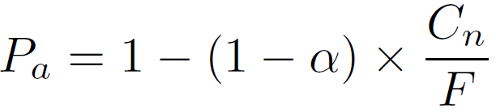
Problem Formulation (7/8)
Assume the cost of unite energy consumption is . When the data is stored at the local FCC cache, the cost is
We assume that the cost of scheduling one file is , the number of files is F , then the probability for scheduling an arbitrary file from other SBSs is
Notes:
Assume the proportion between FCC and DWT is (1 − 𝛼) : 𝛼

Slide 16

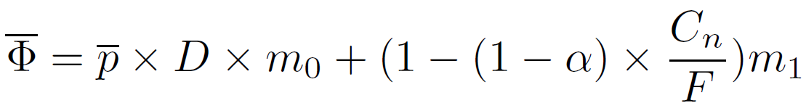
Problem Formulation (8/8)
Therefore, when the data is not stored at the local FCC cache, the cost is
In the system, the average cost for transmitting one file is
Notes:
Assume the proportion between FCC and DWT is (1 − 𝛼) : 𝛼

Slide 17
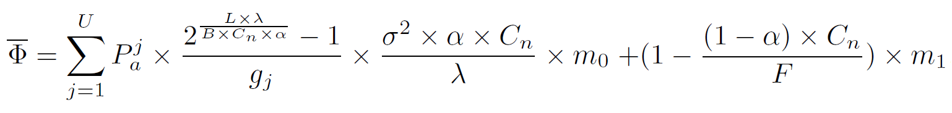
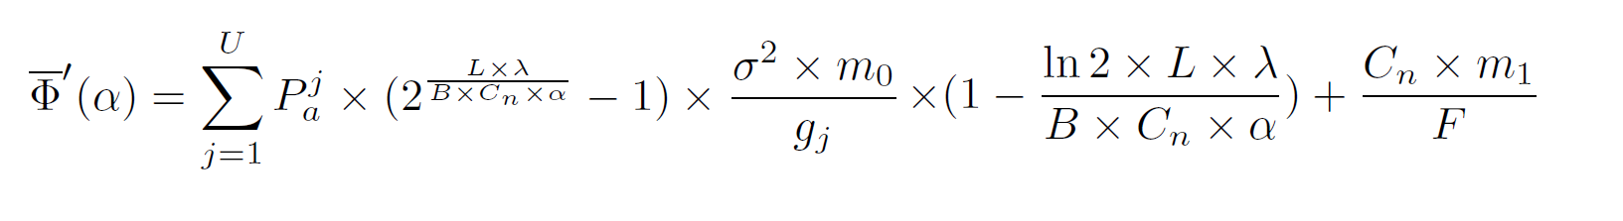
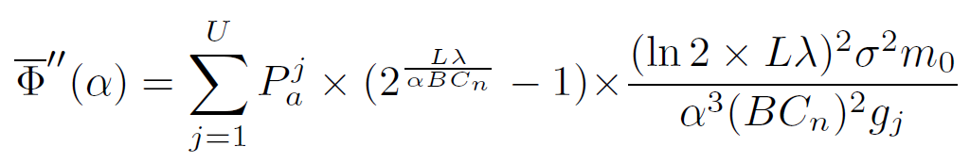


Discussion About The System Costs (1/2)
A smaller 𝛼 leads to larger transmitting power at SBS end, and a larger 𝛼 renders larger possibility of purchasing data copies from other SBSs.
We can see that , and thus is a concave function with respect to 𝛼.
Notes:
因此要 tradeoff alpha 去 minimize system costs
凸(上凹)函數

Slide 18
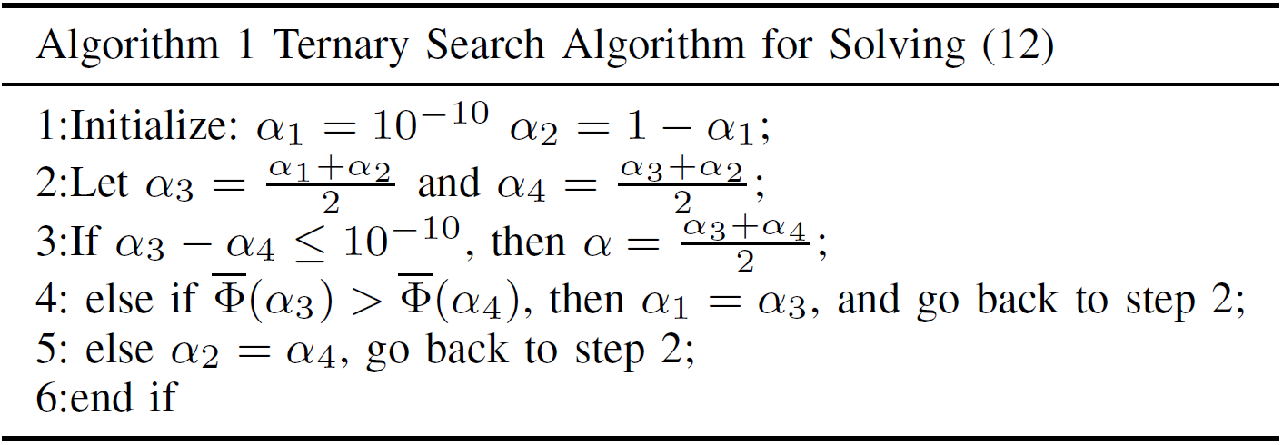
Discussion About The System Costs (2/2)

Slide 19
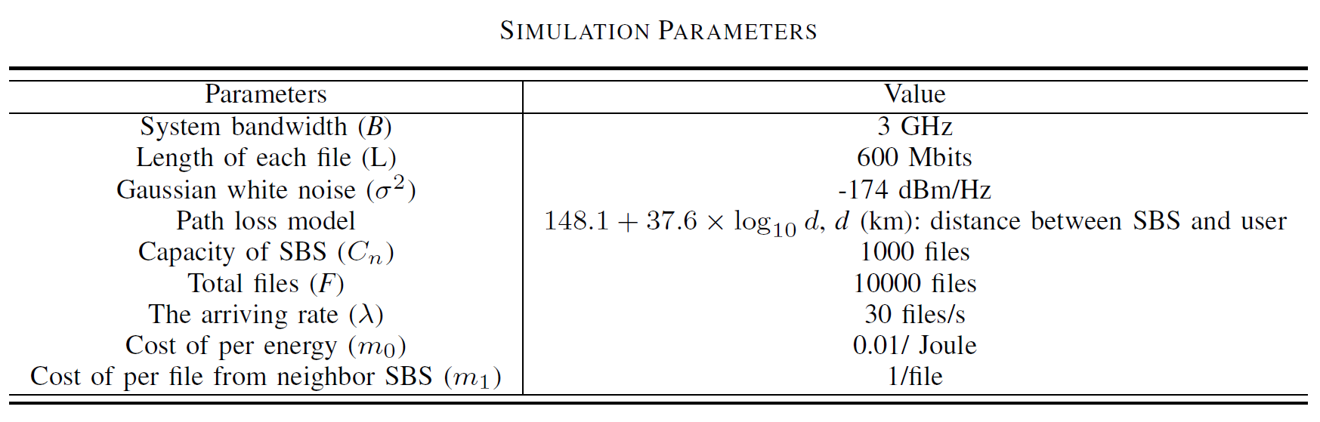
Simulations (1/5)
The SBSs work in the single antenna mode. Cell radius is set to 0.2 kilometers (km), the users can only be directly served by one SBS.

Slide 20
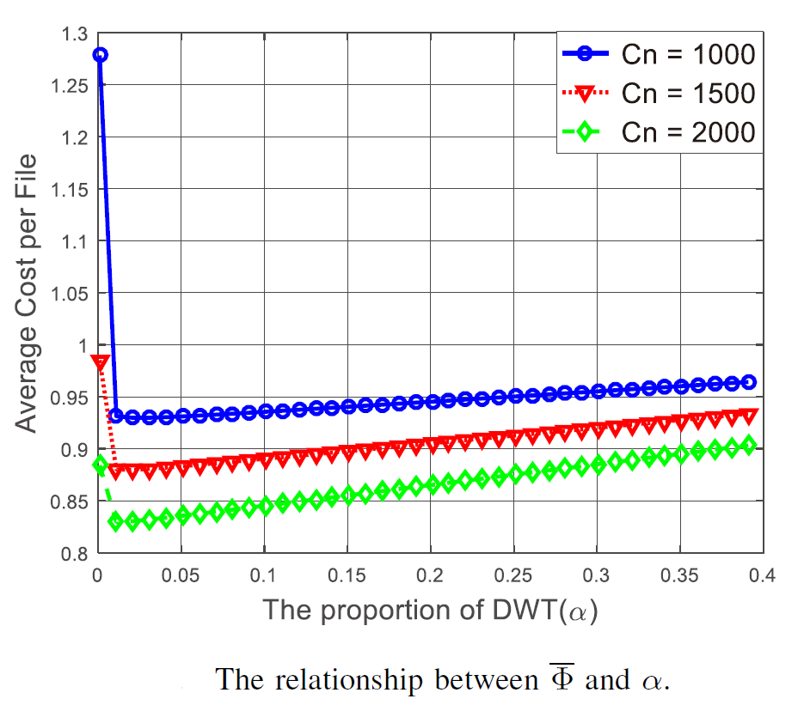
Simulations (2/5)
As 𝛼 increases, the amount of power consumed decreases. Therefore, the system costs decreases.
However, as 𝛼 further increases, the amount of scheduled contents from other SBSs by the users increases. Therefore, the SBS needs to pay more for the scheduled contents and the system cost increases.
when 𝛼 = 1%, the average cost for transmitting one file achieves its minimal value. When 𝛼 > 1%, the average cost increases due to the increased cost of data scheduling.
Notes:
Cn越大 =>cost 越小

Slide 21
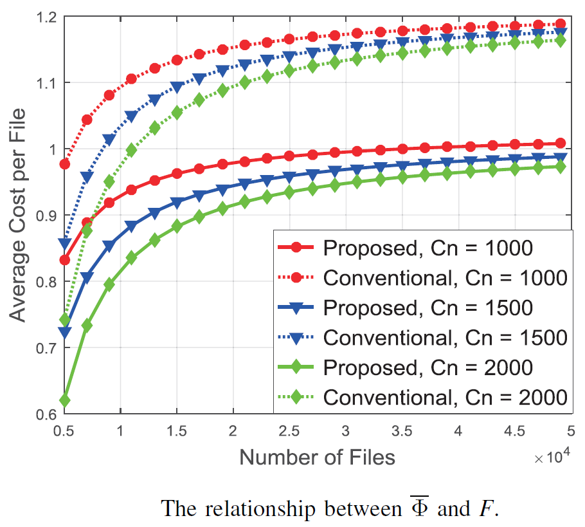
Simulations (3/5)
In traditional method, when the content requested by users not cached in local caching, the SBS needs to get the content from remote server by backhaul, leading to larger cost of routing.
Our proposed scheme outperforms the traditional methods because the data copies of cluster from remote service providers cut down the amount of data for routing.

Slide 22
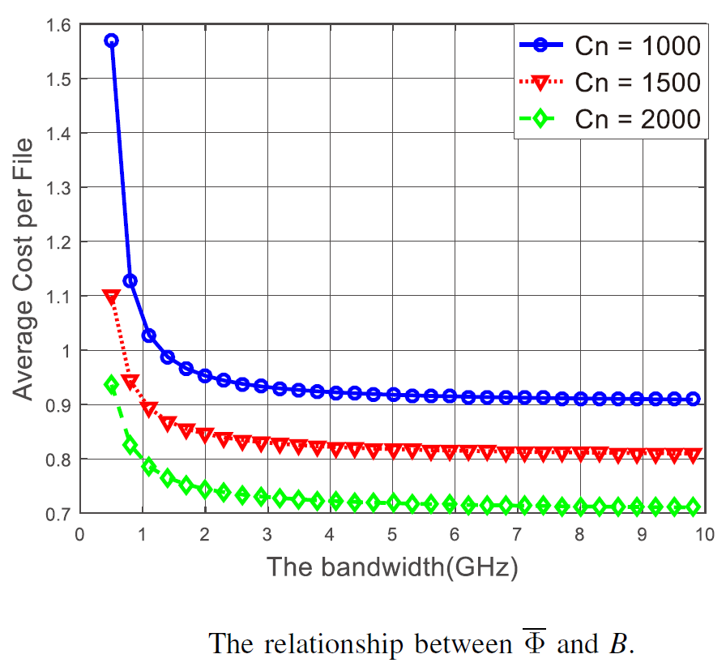
Simulations (4/5)
Figure shows that the average cost per file decreases in the wake of the increasing of the bandwidth.
But when the bandwidth increases to nearly 5GHz, the cut down of the cost followed by the augment of bandwidth is not obvious.
However, when the bandwidth is up to 5GHz or even more, it should seek another method to achieve the purpose of reducing the cost.
Notes:
B越大 =>cost越小

Slide 23
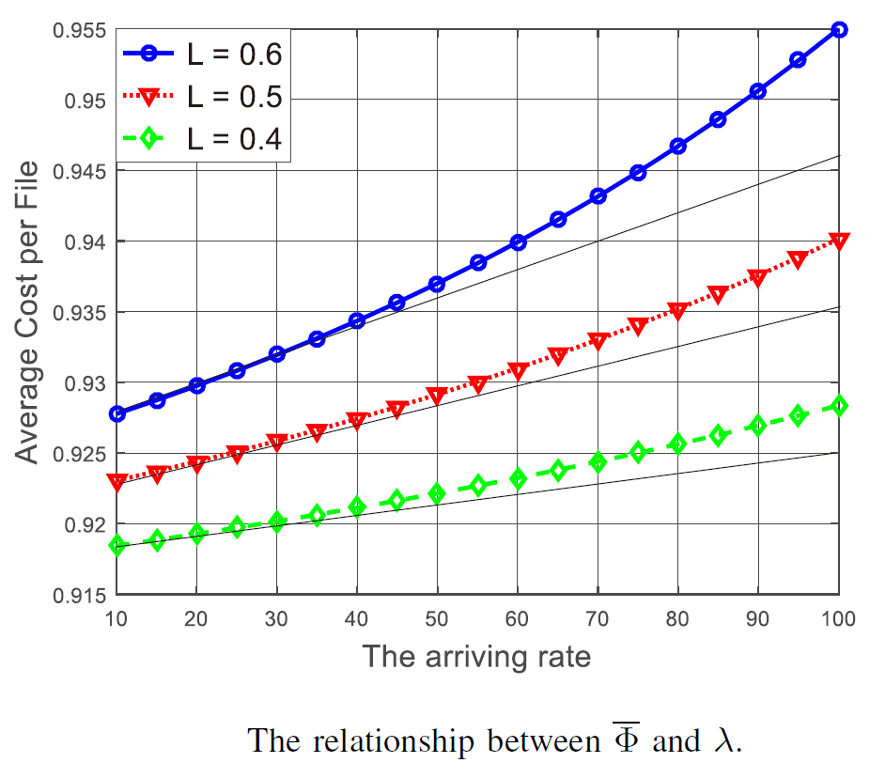
Simulations (5/5)
Figure shows that when the arriving rate is low, the average cost file has linear relationship with the arriving rate.
The reason is that when the arriving rate is much higher, beyond the power of the SBSs, and the space of DWT is limited.
So in the 5G wireless network with the cooperative caching, the arriving rate in one SBS should control under 50, when the arriving rate up to 50 or even more, it should consider to deploy another SBS to reduce the amount of requests in a SBS to lessen the average cost per file.

Slide 24
Conclusion
In this paper, we have proposed a cooperative caching scheme based on content-exchanged in 5G wireless networks to cut down the system costs.
The caching capacity of each SBS is divided into two parts. The former one is used for caching the data copies of remote service providers, and the latter is used for wireless transmission.
We have first proved that the concavity of system costs with respect to the proportion between capacity of the two parts.
We have also proposed the search algorithm of minimal system costs.

Slide 25
Thank you for listening

